Slide 1





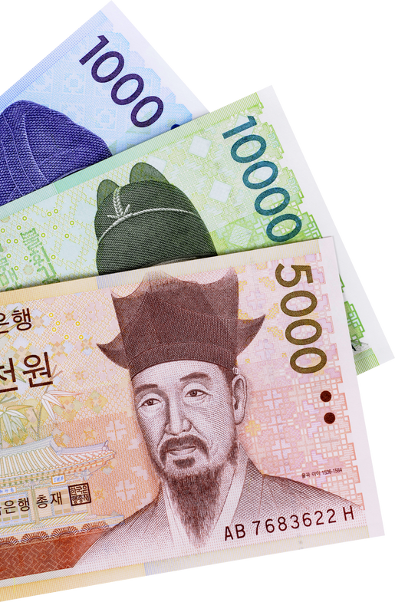

Currency-Projector for global currency
Project 4
Presented by: Group 2
Notes:
Barbie

Slide 2








Team Members
Barbie Hurtado
Stefan Kniejski
David Rojas
Brian Paniagua
Eze Odimegwu
Notes:
Barbie

Slide 3


Project Description
Currency-Projector for global currency creates a model that predicts currency trends based on historical data.
Use time-series analysis and explore techniques for users to interact with the model for investments or currency trading.
Country Segmentation and Regional Analysis to segment currencies based on global behaviors.
Use clustering algorithms like K-Means to group similar currencies and offer insights into global currency trends.
Notes:
Barbie

Slide 4



GLOBAL COMMERCE
CURRENCY TRADING ENABLES SMOOTH INTERNATIONAL TRADE AND INVESTMENT BY MANAGING CURRENCY RISKS & FOSTERING GLOBAL ECONOMIC CONNECTIVITY
currency
market
MARKET DYNAMICS
RISK MITIGATION
TRADING PROVIDES ESSENTIAL TOOLS FOR INDIVIDUALS & BUSINESSES TO HEDGE AGAINST CURRENCY RISK, ENSURING FINANCIAL STABILITY & EFFECTIVE MANAGEMENT OF UNCERTAINTIES
CURRENCY MARKETS SERVE AS EFFICIENT PLATFORMS FOR PRICE DISCOVERY, REFLECTING REAL-TIME ECONOMIC & GEOPOLITICAL CONDITIONS.
Notes:
Barbie

Slide 5




MODEL DESCRIPTION:
OUR LINEAR & POLYNOMIAL MODEL USE:
ARGENTINA’S (ARS - PESO)
CHINA’S (CNY - YUAN)
UK’S (GBP - POUND)
NIGERIA’S (NGN - NAIRA)
COMPARED TO THE US DOLLAR EXCHANGE RATE.
Notes:
Stefan

Slide 6
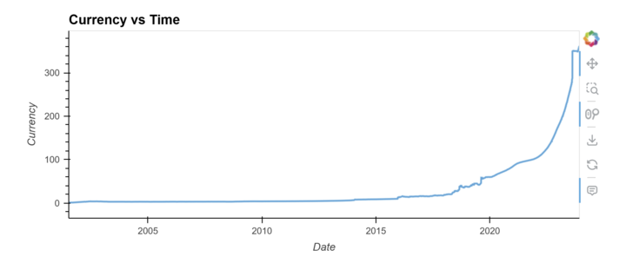
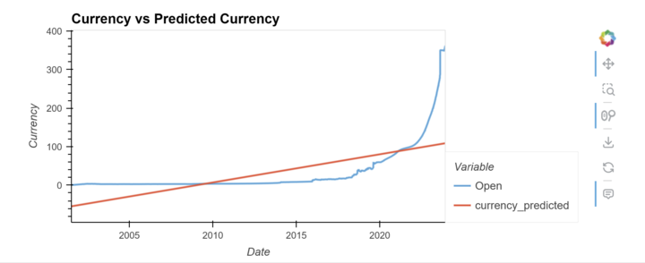
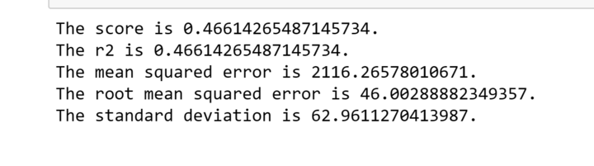
PREDICTING ARGENTINA

Slide 7
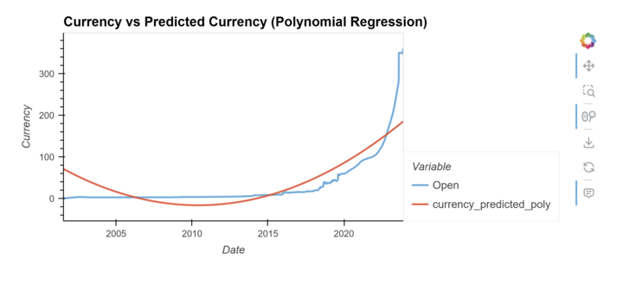
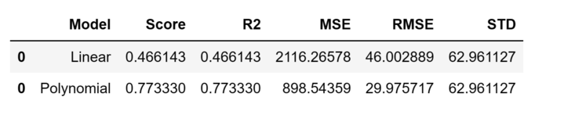
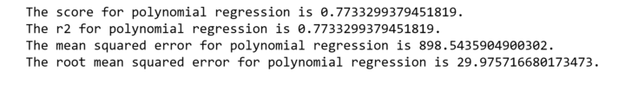
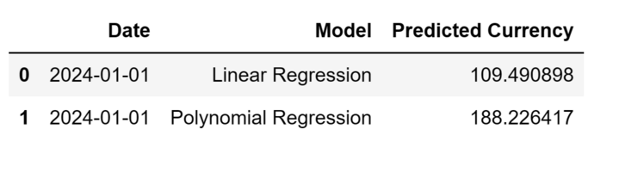
PREDICTING ARGENTINA

Slide 8


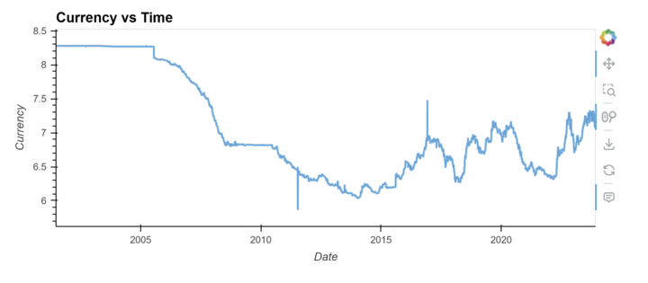
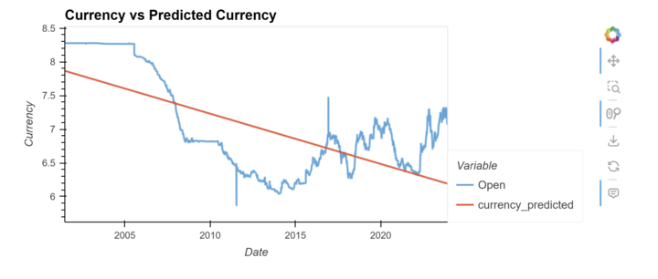

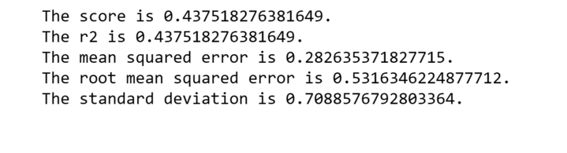
PREDICTING CHINA
@reallygreatsite

Slide 9
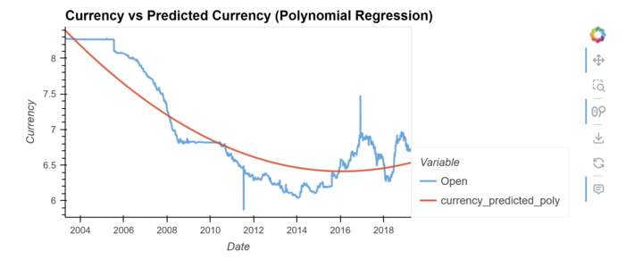
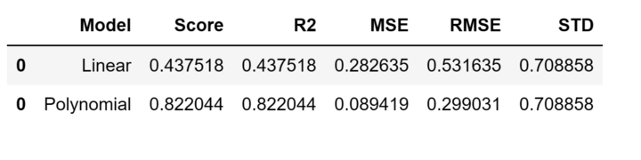
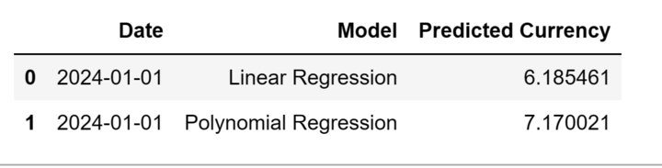
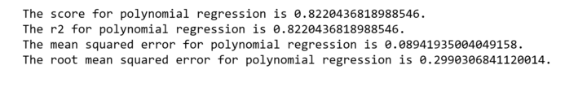
PREDICTING CHINA

Slide 10
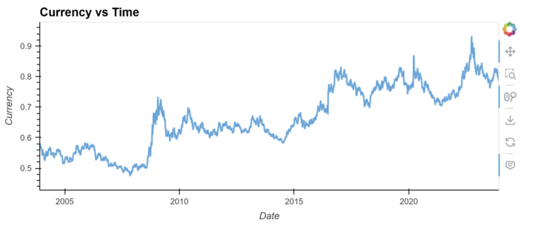
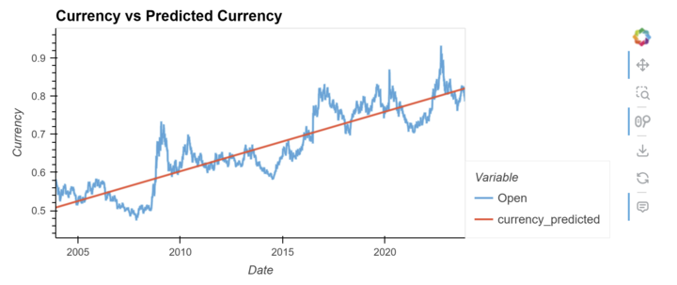
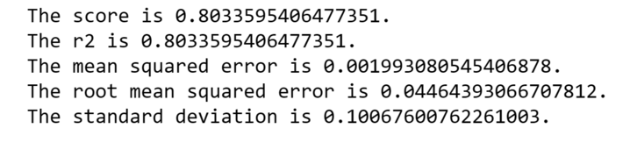
PREDICTING UK

Slide 11
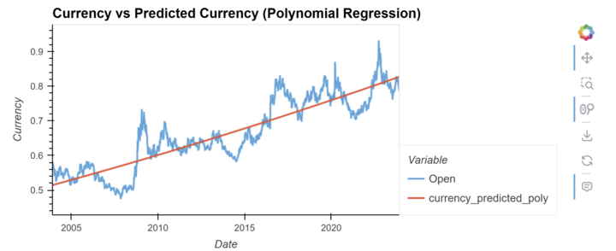
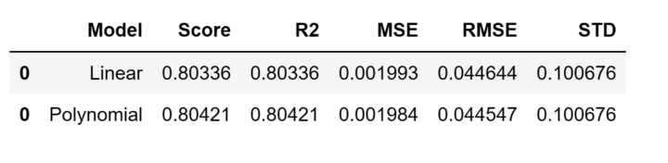
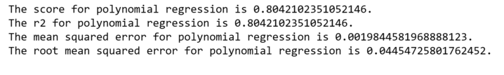
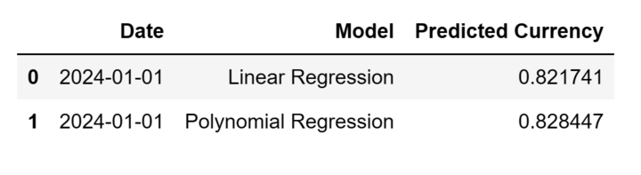
PREDICTING UK

Slide 12
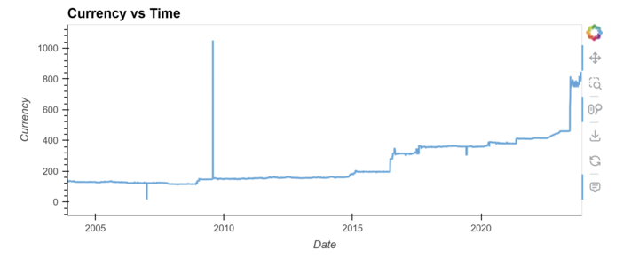
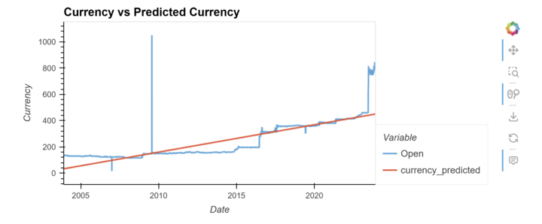
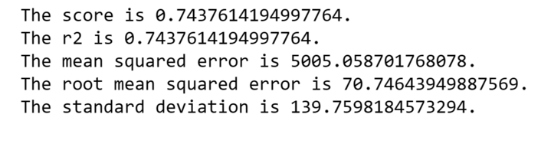
PREDICTING NIGERIA

Slide 13
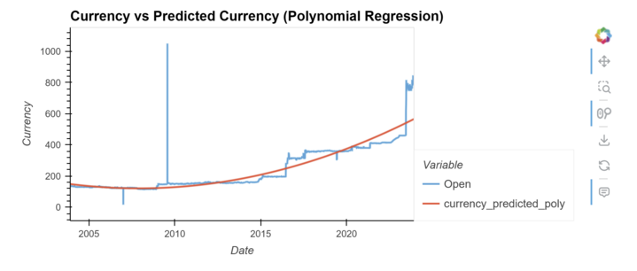
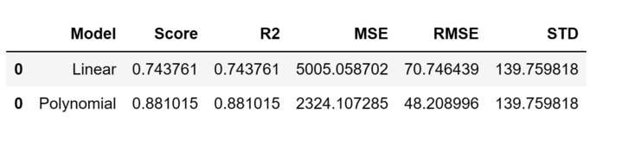
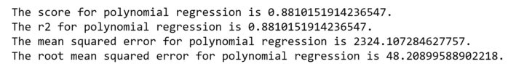
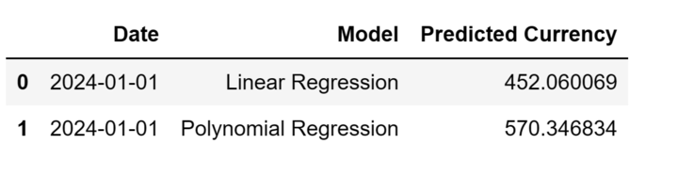
PREDICTING NIGERIA

Slide 14
conclusion
After analyzing these currencies, both models allowed us to visualize the historical data and how it has performed.
By modeling these predictions with both a linear and a polynomial regression, the user can then decide which model best benefits their investment strategies.
Keeping up with exchange rates enables timely modeling and more accurate predictions. Keep in mind, not all currencies behave the same.
Based on the analysis between these 4 currencies, the most stable and investment friendly currency is the UK Pound. Considering how accurate both models were, it also reassured the performance.

Slide 15
Sources
Data Set - Global Currency Historical Pricehttps://www.kaggle.com/datasets/usamabuttar/global-currency-historical-prices-updated-daily/versions/253?resource=downloads [Updated Daily] (kaggle.com)

Slide 16

Thank You
for Listening!
Don't Hesitate To Ask Any Questions

